Slide 1
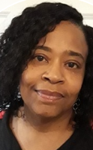
Mrs. Hebron
I am so excited to be your child’s 2nd grade teacher. It’s going to be an awesome year full of new friends and new adventures. This is my 15th year teaching at Herzog Academy.
Your child is cared for and valued. I love seeing children excited about learning. Learning will be fun and sometimes challenging. I believe we can rise to the challenge and be successful!
314-385-2212
Class Dojo
yvette.hebron@slps.org
BOOK
The Talking Eggs
AUTHOR
Patricia McKissack
COLOR
Blue
SPORT
Volleyball
FOOD
Ice cream
Saint Louis Public Schools Graduate
Bachelors in Education – Harris-Stowe State University

